Slide 1
Solving Op Amp Stability Issues Part 3
(For Voltage Feedback Op Amps)
Tim Green & Collin Wells
Precision Analog Linear Applications
<number>
Notes:
This presentation will focus on techniques to solve voltage feedback op amp stability problems. The content is intended to teach any range of professional, from technician to PHD, to become an op amp stability expert!
<number>

Slide 2
Appendix Index
<number>

Slide 3
4) Non-Loop Stability Problems

Slide 4
Non-Loop Stability
Loop Frequencies
RB+
PCB Traces
Supply Bypass
Ground Loops
Output Stage Oscillations
Non-Loop Stability
Oscillations NOT predicted by Loop Gain (Aolβ) Analysis
or
SPICE Simulations
<number>
Notes:
<number>
There are common Non-Loop Stability issues we need to be aware of.

Slide 5
Non-Loop Stability: Loop Frequency Definitions
fcl:
Where Loop Gain (Aolβ) = 1
fGBW:
Where Op Amp Aol Curve crosses 0dB
(Unity Gain Bandwidth)
<number>
Notes:
<number>
To clarify Non-Loop Stability issues we see above that oscillations at any frequency beyond fcl ARE NOT Loop Stability issues that are predictable by Loop Gain Analysis or SPICE simulations.

Slide 6
Non-Loop Stability: ? Diagnostic Questions ?
Frequency of oscillation (fosc)?
When does the oscillation occur?
Oscillates Unloaded?
Oscillates with V_{IN}=0?
<number>
Notes:
<number>
To help easily diagnose what the cause of instability is we need to know the answers to a few simple questions as shown above.

Slide 7
Non-Loop Stability: RB+ Resistor
fosc < fGBW
oscillates unloaded? -- may or may not
oscillates with V_{IN}=0? -- may or may not
RB+ is Ib current match resistor to reduce Vos errors due to Ib.
RB+ can create high impedance node acting as antenna pickup for unwanted positive feedback.
PROBLEM
SOLUTION
SOLUTION
If you use RB+ bypass it in parallel with 0.1μF capacitor.
Many Op Amps have low Ib so error is small. Evaluate DC errors w/o RB+.
<number>
Notes:
<number>
The infamous input bias impedance matching resistor can become a problem for AC frequencies if proper design considerations are not used.

Slide 8
Non-Loop Stability: PCB Traces
fosc < fGBW
oscillates unloaded? -- may or may not
oscillates with V_{IN}=0? -- may or may not
DO NOT route high current, low impedance output traces near high impedance input traces. Unwanted positive feedback path.
DO route high current output traces adjacent to each other (on top of each other in a multi-layer PCB) to form a twisted pair for EMI cancellation.
<number>
Notes:
<number>
When dealing with high current output traces we need to take the necessary precautions to keep low impedance output traces away from high impedances input traces.

Slide 9
Non-Loop Stability: Supply Lines
fosc < fGBW
oscillates unloaded? -- no
oscillates with V_{IN}=0? -- may or may not
PROBLEM
PROBLEM
Power supply lead inductance, Ls, interacts with a capacitive load, CL, to form an oscillatory LC, high Q, tank circuit.
Load current, IL, flows through power supply resistance, Rs, due to PCB trace or wiring. Modulated supply voltages appear at Op Amp Power pins. Modulated signal couples into amplifier which relies on supply pins as AC Ground.
<number>
Notes:
<number>
Supply lines can present Non-Loop Stability problems as shown above.

Slide 10
Non-Loop Stability: Proper Supply Line Decouple
SOLUTION
C_{LF}: Low Frequency Bypass
10μF / Amp Out (peak)
Aluminum Electrolytic or Tantalum
< 4 in (10cm) from Op Amp
C_{HF}: High Frequency Bypass
0.1μF Ceramic
Directly at Op Amp Power Supply Pins
R_{HF}: Provisional Series C_{HF} Resistance
1Ω < R_{HF} < 10Ω
Highly Inductive Supply Lines
<number>
Notes:
<number>
Solutions to power supply line problems are easy and good design practice in general as shown above.

Slide 11
Non-Loop Stability: Ground Loops
fosc < fGBW
oscillates unloaded? -- no
oscillates with V_{IN}=0? -- yes
SOLUTION
PROBLEM
Ground loops are created from load current flowing through parasitic resistances. If part of V_{OUT} is fed back to Op Amp +input, positive feedback and oscillations can occur.
Parasitic resistances can be made to look like a common mode input by using a “Single-Point” or “Star” ground connection.
<number>
Notes:
<number>
Grounding can also present Non-Loop Stability problems much like power supply line problems as we see here. Again the solution is good design practice.

Slide 12
Non-Loop Stability: Output Stages
fosc > fGBW
oscillates unloaded? -- no
oscillates with V_{IN}=0? -- no
PROBLEM
SOLUTION
Some Op Amps use composite output stages, usually on the negative output, that contain local feedback paths. Under reactive loads these output stages can oscillate.
The Output R-C Snubber Network lowers the high frequency gain of the output stage preventing unwanted oscillations under reactive loads.
<number>
Notes:
<number>
The last common Non-Loop stability problem has to do with Semiconductor IC output stage topologies in Op Amps as shown. Again the solution is fairly simple if it is designed in up front.

Slide 13
5) Riso (Output Cload)

Slide 14
Loaded Aol
<number>
Notes:
<number>
A loop gain analysis circuit can be used to analyze the “Loaded Aol” due to CLoad. As shown here the “Loaded Aol” curve due to CLoad, 1uF, has an additional pole in it around 3kHz, fp2. fp1 is the original pole in the Aol curve of the op amp before CLoad is applied. Since the circuit is running as a unity gain follower 1/β is 0dB and at fcl, where 1/β intersects the Loaded Aol curve we see a 40dB/decade rate-of-closure which is UNSTABLE by our rate-of-closure criteria.

Slide 15
Loaded Aol Model
<number>
Notes:
<number>
Our stability analysis of the effects of capacitive loading on an op amp will be simplified by the introduction of the “Loaded Aol Model”. As shown in this slide the data sheet Aol curve is followed by the op amp output resistance, Ro. The capacitive load, CLoad, in conjunction with Ro will form an additional pole in the Aol plot and may be represented by a new “Loaded Aol” plot. The Ro-CLoad network form the “Aol Load” on the original op amp “Aol”.

Slide 16
Loaded Aol Model
fp2
<number>
Notes:
<number>
The data sheet Aol is loaded by the Ro-CLoad load network as shown here. The additional pole, fp2, due to Ro and CLoad is computed here.

Slide 17
Loaded Aol Model
fp2
fp1
Aol
Aol Load
+
fp1
Loaded Aol
fp2
=
<number>
Note: Addition on Bode Plots = Linear Multiplication
Notes:
<number>
The op amp original “Aol” is “multiplied” by the “Aol Load” to yield the resultant “Loaded Aol” curve. On dB plots linear multiplication is performed by adding the curves in dB. As shown above it becomes easy to see the resultant “Loaded Aol” by adding the op amp original “Aol” plus the “Aol Load” formed by Ro-CLoad.

Slide 18
Loaded Aol – Loop Gain & Phase
Phase Margin at fcl
<number>
Notes:
<number>
The Loaded Aol caused by CLoad, 1uF, will result in Loop Gain phase margin at fcl of only 0.548 degrees. This is definitely and UNSTABLE circuit as it stands here.

Slide 19
Riso Compensation
Riso will add a zero in the Loaded Aol Curve
<number>
Notes:
<number>
One way to compensate the op amp circuit for CLoad is to add Riso Compensation. Note the point of feedback for the circuit is still taken directly at the output of the op amp. The addition of Riso will add a zero into the “Loaded Aol” curve and stabilize the circuit.

Slide 20
Riso Compensation Results
<number>
Notes:
<number>
The Riso Compensation will add fz1 into the “Loaded Aol” which will result in a -20dB/decade slope crossing 0db at fcl. This will result in a stable circuit by our rate-of-closure criteria of 20dB/decade indicating stability.

Slide 21
Riso Compensation Theory
<number>
Notes:
<number>
Our stability analysis using the “Loaded Aol Model” will be analyzed for the addition of the Riso Compensation. The data sheet Aol curve is followed by the op amp output resistance, Ro, Riso Compensation, Riso and load capacitance, CLoad. Note the point of feedback is between Ro and Riso. The capacitive load, CLoad, in conjunction with Ro and Riso will form an additional pole in the Loaded Aol plot. The capacitive load, CLoad, in conjunction with Riso will add a zero in the Loaded Aol plot.

Slide 22
Riso Compensation Theory
fp2
fz1
<number>
Notes:
<number>
The data sheet Aol is loaded by the Ro-Riso-CLoad load network as shown here. The additional pole, fp2, due to Ro + Riso and CLoad is computed here. Also we see a zero, fz1, formed by Riso and Cload.

Slide 23
Riso Compensation Theory
fp1
Aol
fp2
fz1
Aol Load
+
fp1
Loaded Aol
fp2
fz1
=
<number>
Note: Addition on Bode Plots = Linear Multiplication
Notes:
The op amp original “Aol” is “multiplied” by the “Aol Load” with Riso Compensation to yield the resultant “Loaded Aol” curve. On dB plots linear multiplication is performed by adding the curves in dB. As shown above it becomes easy to see the resultant “Loaded Aol” by adding the op amp original “Aol” plus the “Aol Load” formed by the Ro-Riso-CLoad combination.

Slide 24
Riso Compensation Design Steps
Determine fp2 in Loaded Aol due to CLoad
Measure in SPICE with CLoad on Op Amp Output
Plot fp2 on original Aol to create new Loaded Aol
3) Add Desired fz2 on to Loaded Aol Plot for Riso Compensation
Keep fz1 < 10*fp2 (Case A)
Or keep the Loaded Aol Magnitude at fz1 > 0dB (Case B)
(fz1>10dB will allow for Aol variation of ½ Decade in Unity Gain Bandwidth)
4) Compute value for Riso based on plotted fz1
5) SPICE simulation with Riso for Loop Gain (Aolβ) Magnitude and Phase
Adjust Riso Compensation if greater Loop Gain (Aolβ) phase margin desired
Check closed loop AC response for VOUT/VIN
Look for peaking which indicates marginal stability
Check if closed AC response is acceptable for end application
Check Transient response for VOUT/VIN
Overshoot and ringing in the time domain indicates marginal stability
Determine if settling time is acceptable for end application
<number>
Notes:
<number>
The Riso Compensation design steps are outlined here. Two cases, Case A and Case B, will be presented. Rules-of-thumb will be presented to yield best stability on first pass analysis.

Slide 25
1),2) Loaded Aol and fp2
Case A, CLoad=1uF, fp2=2.98kHz
Case B, CLoad=2.9nF, fp2=983.37kHz
<number>
Notes:
<number>
Two different CLoads will be analyzed to show rules-of-thumb to get the best stability using Riso Compensation. Case A will use CLoad = 1uF and Case B will used CLoad = 2.9nF. By setting Riso = 0 ohms we can easily analyze the Loaded Aol for each case without Riso Compensation. From above Loaded Aol plots we can use the phase plots to determine the pole locations of fp2 for each of Case A, CLoad=1uF and Case B, CLoad=2.9nF.
From above we have completed Steps 1 and 2 for the Riso Compensation Design:
Determine fp2 in Loaded Aol due to CLoad
Measure in SPICE with CLoad on Op Amp Output
Plot fp2 on original Aol to create new Loaded Aol

Slide 26
3) Add fz1 on Loaded Aol
Case A, CLoad=1uF, fz1=29.8kHz
Case B, CLoad=2.9nF, fz1=4.07MHz
<number>
Notes:
<number>
Our Loaded Aol curves for Case A, CLoad=1uF and Case B, CLoad=2.9nF, found using Step 1 and Step 2, are shown above. We can add straight line approximations to the magnitude plot (-20dB/decade slope) to indicate how and where we want to modify the Loaded Aol curve so the unity gain buffer (1/β = 0dB) will be stable with each respective capacitive load. These lines are added per the recommended rules-of-thumb below in Step 3.
From above we have completed Step 3 for the Riso Compensation Design:
3) Add Desired fz2 on to Loaded Aol Plot for Riso Compensation
Keep fz1 < 10*fp2 (Case A)
Or keep the Loaded Aol Magnitude at fz1 > 0dB (Case B)
(fz1>10dB will allow for Aol variation of ½ Decade in Unity Gain Bandwidth)

Slide 27
4) Compute Value for Riso
Case A, CLoad=1uF, fz1=29.8kHz
Case B, CLoad=2.9nF, fz1=4.07MHz
<number>
Notes:
<number>
From Riso Compensation Design Step 3 we know the respective locations we want for fz1. From that we can compute Riso and choose a standard resistor value.
From above we have completed Step 4 for the Riso Compensation Design:
4) Compute value for Riso based on plotted fz1

Slide 28
5),6) Loop Gain, Case A
Phase Margin at fcl = 87.5 degrees
<number>
Notes:
<number>
Design Step 5 for Riso Compensation is to check the final Riso value chosen by a loop gain plot on the complete op amp circuit. We see from above that for Case A, CLoad=1uF, at fcl, where Loop Gain (Aolβ) goes to zero, the phase margin is 87.5 degrees. Step 6 is to adjust Riso for more phase margin if we are not satisfied with our first analysis and re-run the loop gain and phase plot to check the final design. Here we are happy with 87.5 degrees of Loop Gain (Aolβ) phase margin.
From above we have completed Steps 5 & 6 for the Riso Compensation Design:
SPICE simulation with Riso for Loop Gain (Aolβ) Magnitude and Phase
Adjust Riso Compensation if greater Loop Gain (Aolβ) phase margin desired

Slide 29
5),6) Loop Gain, Case B
Phase Margin at fcl = 54 degrees
<number>
Notes:
<number>
Design Step 5 for Riso Compensation is to check the final Riso value chosen by a loop gain plot on the complete op amp circuit. We see from above that for Case B, CLoad=2.9nF, at fcl, where Loop Gain (Aolβ) goes to zero, the phase margin is 54.2 degrees. Step 6 is to adjust Riso for more phase margin if we are not satisfied with our first analysis and re-run the loop gain and phase plot to check the final design. Here we are happy with 54.2 degrees of Loop Gain (Aolβ) phase margin.
From above we have completed Steps 5 & 6 for the Riso Compensation Design:
SPICE simulation with Riso for Loop Gain (Aolβ) Magnitude and Phase
Adjust Riso Compensation if greater Loop Gain (Aolβ) phase margin desired

Slide 30
7) AC VOUT/VIN, Case A
<number>
Notes:
<number>
Design Step 7 for Riso Compensation is to check the closed loop AC response over frequency. From above, for Case A, CLoad=1uF, we see the closed loop AC response for both the output of the op amp, VOA, and the output after Riso, VOUT. If this closed loop bandwidth is not acceptable for the final application we will need to consider other capacitive stability techniques (see Appendix) or a different op amp or different load capacitance value.
From above we have completed Step 7 for the Riso Compensation Design:
Check closed loop AC response for VOUT/VIN
Look for peaking which indicates marginal stability
Check if closed AC response is acceptable for end application

Slide 31
8) Transient Analysis, Case A
<number>
Notes:
<number>
Design Step 8 for Riso Compensation is to check the closed loop transient response. From above, for Case A, CLoad=1uF, we see the closed loop Transient response for both the output of the op amp, VOA, and the output after Riso, VOUT show no signs of excessive overshoot or ringing before settling.
From above we have completed Step 7 for the Riso Compensation Design:
Check Transient response for VOUT/VIN
A) Overshoot and ringing in the time domain indicates marginal stability

Slide 32
Riso Compensation: Key Design Consideration
Accuracy of VOUT depends on Load Current
Light Load Current
Heavy Load Current
<number>
Notes:
<number>
The Riso Compensation has one key design consideration with regards to accuracy at VOUT for heavy loads. The feedback for voltage accuracy is directly at the output of the op amp and the VOUT at the load is isolated by Riso. If output currents are large and depending upon the value of Riso the voltage at VOUT will not be the voltage at VIN for the unity gain follower shown above. If this is a problem in the end application a different compensation technique for the CLoad will need to be used (see Appendix for alternative compensation methods for output capacitive loads).

Slide 33
6) High Gain and CF (Output Cload)
<number>

Slide 34
Original Circuit: Transient Response
<number>

Slide 35
High-Gain and CF Compensation Design Steps
Break the loop and plot Aol and 1/Beta
Determine fp2 in Loaded Aol due to Cload
Determine fcl of original Aol and 1/Beta
Determine f(Aol=0dB)
f(Aol=0dB): the frequency where the Loaded Aol Magnitude = 0dB
Add Desired fp3 to 1/Beta for CF compensation (fz1 will occur when 1/Beta = 0dB)
Keep fp3 < *fcl and fz1 < f(Aol=0dB)
To prevent AolB phase dip, Keep fp3 < 10*fp2
3) Select value for CF based fp3, fcl, and f(Aol=0dB)
SPICE simulation with Riso for Loop Gain (Aolβ) Magnitude and Phase
Adjust CF if greater Loop Gain (Aolβ) phase margin desired
Check closed loop AC response for VOUT/VIN
Look for peaking which indicates marginal stability
Check if closed AC response is acceptable for end application
7) Check Transient response for VOUT/VIN
A) Overshoot and ringing in the time domain indicates marginal stability
<number>
Notes:
<number>

Slide 36
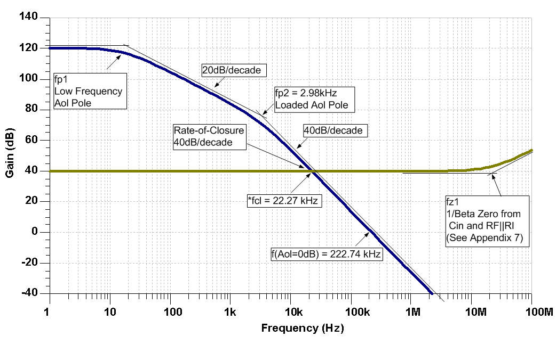
1) Original Circuit: Break the Loop
<number>

Slide 37
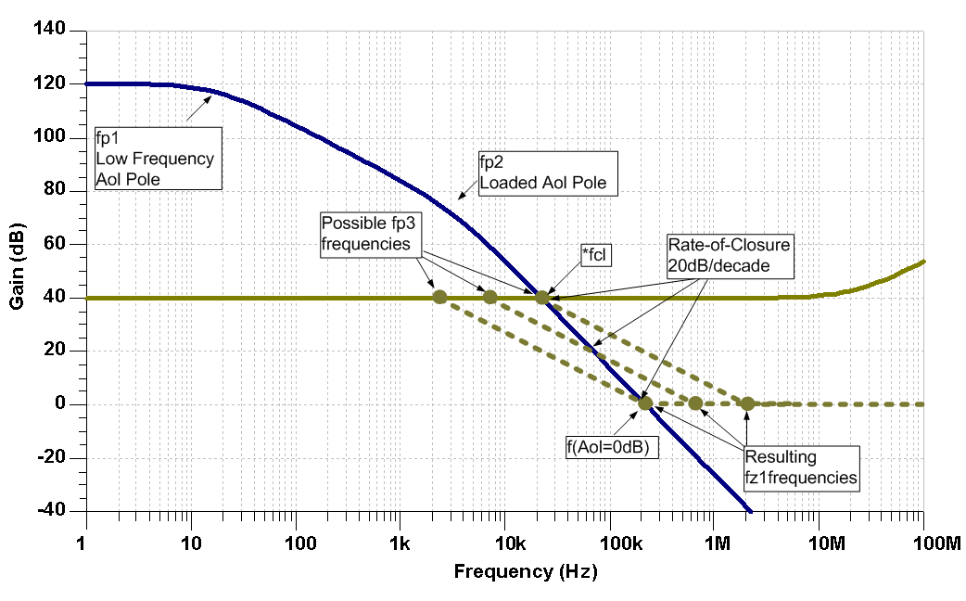
2) Compensate with 1/Beta Pole (CF)
<number>

Slide 38
3) 1/Beta Pole/Zero Equations
1/Beta Transfer Function:
DC 1/Beta:
1/Beta Pole Frequency:
=> Solve for CF
CI is the equivalent input capacitance of the op amp. (See Appendix #7)
1/Beta Zero Frequency:
=> Solve for CF
<number>

Slide 39
3) Select CF to Compensate Circuit
From Step 1:
For stability:
Keep fp3 < *fcl and fz1 < f(Aol=0dB)
Calculate CF(min) from fp3 < *fcl :
Calculate CF(max) from fz1 < f(Aol=0dB) :
B) To prevent AolB phase dip, Keep fp3 < 10*fp2

Slide 40
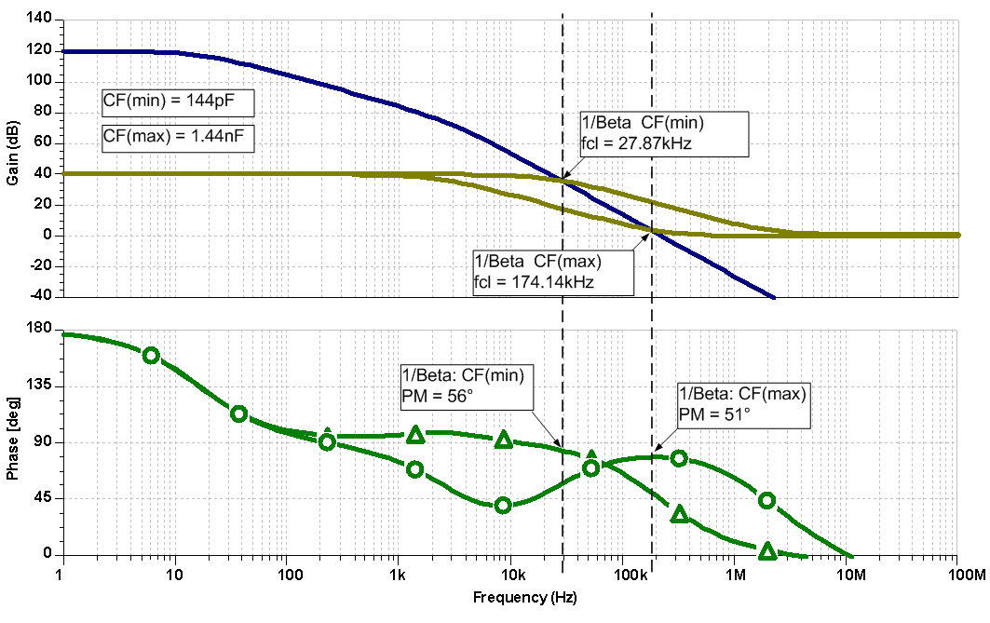
4),5) Plot Aol and 1/Beta for Compensated Circuit
<number>

Slide 41
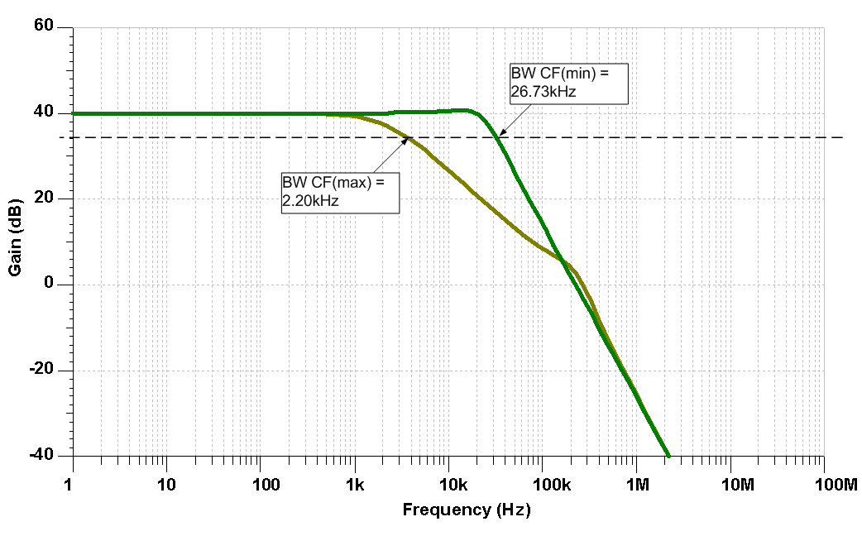
6) Plot Compensated Closed-Loop Gain
<number>

Slide 42
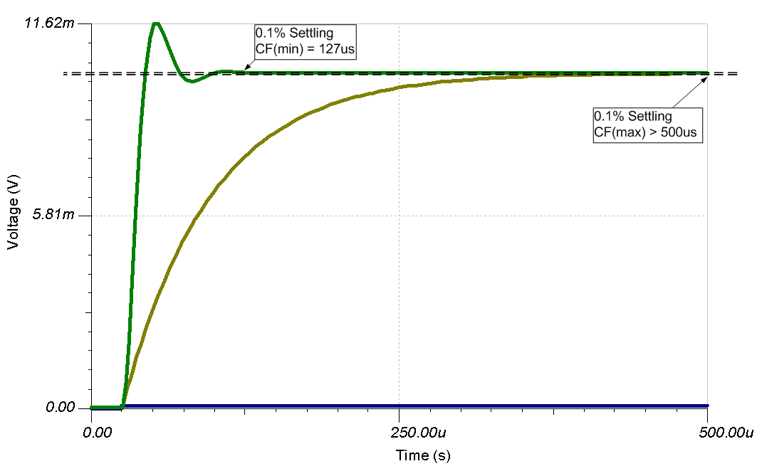
7) Plot Compensated Transient Response
<number>

Slide 43
High Gain and CF Summary
Select CF between CF(min) and CF(max) for stability
CF(min) and CF(max) produce similar phase-margins
CF(min) will have the largest closed-loop bandwidth and fastest transient response
CF(max) will produce the smallest closed-loop BW and the slowest transient response
Selecting a value between CF(min) and CF(max) will produce the most robust design
<number>

Slide 44
7) CF Non-Inverting (Input Cload)
<number>

Slide 45
Op Amp Input Capacitance
<number>

Slide 46
Op Amp Input Capacitance
<number>

Slide 47
Equivalent Input Capacitance and 1/β
(Set to 1V)
β
<number>
Notes:
<number>

Slide 48
CF Compensation Design Steps
Determine fz1 in 1/β due to Cin_eq
Measure in SPICE
OR
B) Compute by Datasheet C_{DIFF} and C_{CM} and Circuit RF and RI
Plot 1/β with fz1 on original Aol
3) Add Desired fp1 on 1/β for CF Compensation
Keep fp < 10*fz
Keep fp < 1/10 * fcl
Compute value for CF based on plotted fp
5) Check CF Compensation by 1/β plot on Aol
6) SPICE simulation with CF for Loop Gain (Aolβ) Magnitude and Phase
7) Adjust CF Compensation if greater Loop Gain (Aolβ) phase margin desired
8) Check closed loop AC response for VOUT/VIN
Look for peaking which indicates marginal stability
Check if closed AC response is acceptable for end application
9) Check Transient response for VOUT/VIN
A) Overshoot and ringing in the time domain indicates marginal stability
<number>
Notes:
<number>
The CF Compensation design steps are outlined here. Rules-of-thumb are presented to yield best stability on first pass analysis.

Slide 49
1),2),3) Plot Aol, 1/β, Add fp in 1/β for Stability
Add fp here?
<number>

Slide 50
4) Compute Value for CF based on location of fp
Note: Location of fz
changes when CF is added
<number>

Slide 51
4) Compute Value for CF based on location of fp
Maximum Bandwidth CF Compensation for Cin
For maximum Closed Loop Bandwidth for VOUT / VIN:
CF needs to compensate input capacitance of Ccm- only since gain effects of Cdiff are nulled out
(Similar to Non-Inverting Noise Gain op amp configuration)
2) Stability and phase margin are still determined by Cin_eq (Cdiff // Ccm-)
Complete Circuit
Loop Gain Model
Closed Loop VOUT / VIN Model
<number>

Slide 52
5) Check CF Compensation by 1/β on Aol
Maximum Closed Loop BW
<number>

Slide 53
6),7) Loop Gain Check
Maximum Closed Loop BW
<number>

Slide 54
8) AC Closed Loop Vout/Vin
Maximum Closed Loop BW
Maximum Closed Loop BW
<number>

Slide 55
9) Transient Analysis
<number>

Slide 56
9) Transient Analysis
<number>

Slide 57
9) Transient Analysis
<number>

